Slide 1
SPECIAL TOPIC - MINI PROJECT Credit Card Fraud Detection Using Ensemble learning Models
TEAM DETAILS
NAME | SRN | SEMESTER & SECTION
SIDDHANT KUMAR | PES2201800129 | 5 & B
SAURAV PRASAD | PES2201800098 | 5 & D
DHOLU JHA | PES2201800161 | 5 & C

Slide 2
PROBLEM STATEMENT
Credit card fraud events take place frequently and then result in huge financial losses. Criminals can use some technologies such as Trojan or Phishing to steal the information of other people’s credit cards. Therefore, we will design an effective fraud detection method that can identify a fraud in time when a criminal uses a stolen card to consume.

Slide 3
ABSTRACT
Recent research has shown that machine learning techniques have been applied very effectively to the problem of payments related fraud detection. Such ML based techniques have the potential to evolve and detect previously unseen patterns of fraud. We applied multiple ML techniques based on Random Forest and its variation such as Refined Weighted Random Forest and SMOTE(logistic regression) to the problem of credit fraud detection using a labelled dataset containing fraud and non-fraud transactions. We will try to make our proposed approaches to detect fraud transactions with high accuracy and reasonably low number of false positives. Random forest (RF) is widely used in many applications due to good classification performance. However, its voting mechanism assumes that all base classifiers have the same weight. We mainly focus on the weighted voting mechanism and then propose a novel weighted RF. SMOTE stands for Synthetic Minority Over-sampling Technique. In this technique we basically generate synthetic points for minority class to make the number of minority samples (fraud examples) equal to that of majority samples(non-fraud examples). Then we use logistic regression to train the model. At last we compare the results.

Slide 4
METHODOLOGY USED
The ML technique used is Random Forest and its variation such as Refined Weighted Random Forest and SMOTE(Logistic Regression).
Refined Weighted Random Forest : In fraud detection dataset we will have very less fraud examples compared to non-fraud examples.
SMOTE(Logistic Regression) Prediction

Slide 5
EXPECTED RESULT
Calculating the accuracy of the training model by comparing with the test model and then comparing the accuracy of the model with different research papers. Depending on the accuracy and precision of the model,we can further go ahead for fine tuning of the model for better outcomes.

Slide 6
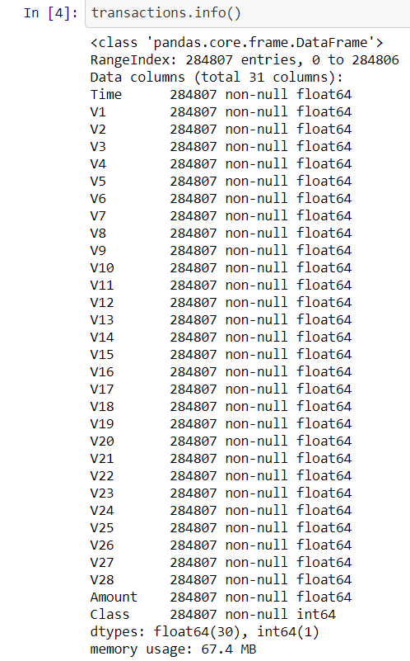
Dataset Description

Slide 7

Are there any missing values n the dataset?

Slide 8
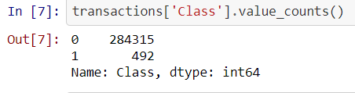
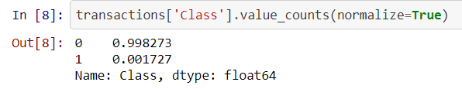
How common are fraudulent data transaction?

Slide 9
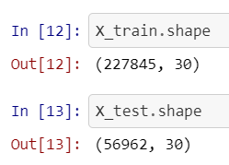

Train/Test Split
We'll use a test size of 20%. We also stratify the split on the labels, which is very important to do because there are so few fraudulent transactions.
The above screenshot shows us that the transactions occur over a two day period.

Slide 10
Visualization

Slide 11
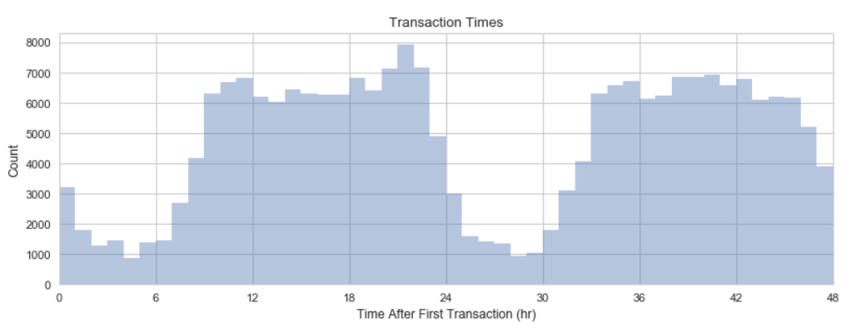
Transaction Time
(Histogram)
This is the histogram of transaction times with one bin per hour. We see that there are two lulls in credit card transactions during nighttime on each day.

Slide 12
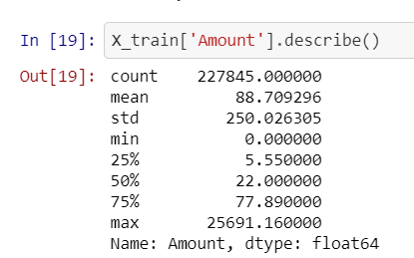
Amount Statistics
If we will compare different quantities it looks like that the amounts are very right-skewed.

Slide 13
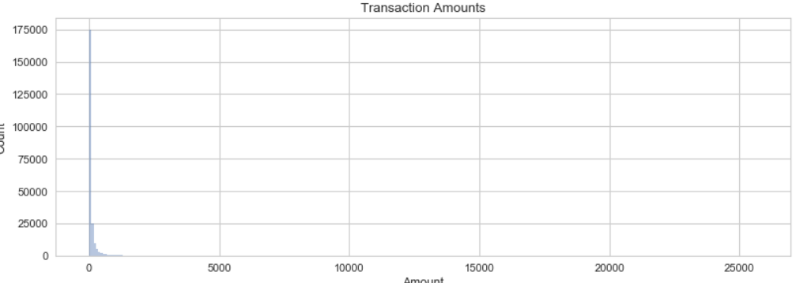
Transaction Amount vs Count
By looking at this histogram, it looks like that there are many outliers. We will verify it by plotting the box plot.

Slide 14
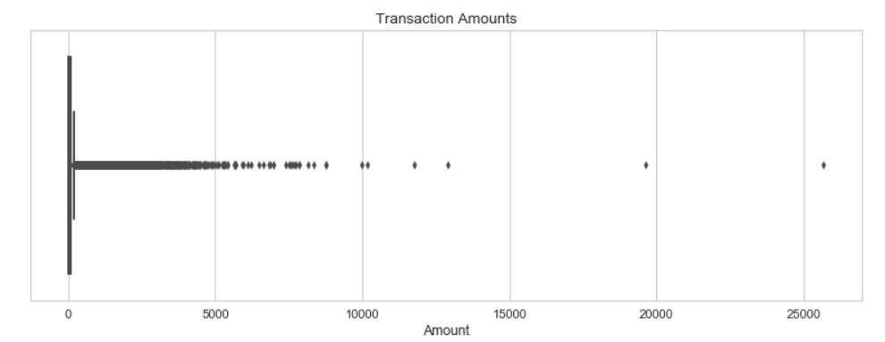

Box plot(Transaction Amounts)
We can clearly see that there are many outliers in the right side compared to the left side which indicates that the amounts are right-skewed.

Slide 15
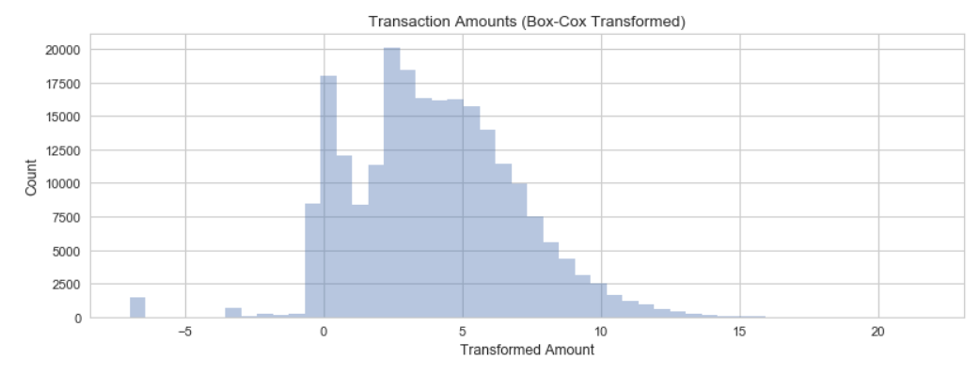
Normal Distribution of Amount
We will perform a power transform to bring the transaction amounts closer to a normal distribution. But at first we will make the amounts positive which are have zero as a value.
The distribution is bimodal which shows us that a division is necessary between small and large purchases.

Slide 16
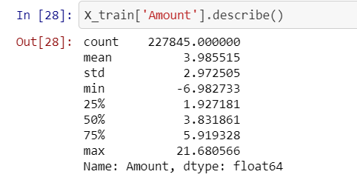

The Updated statistics

Slide 17
Descriptive statistics

Slide 18
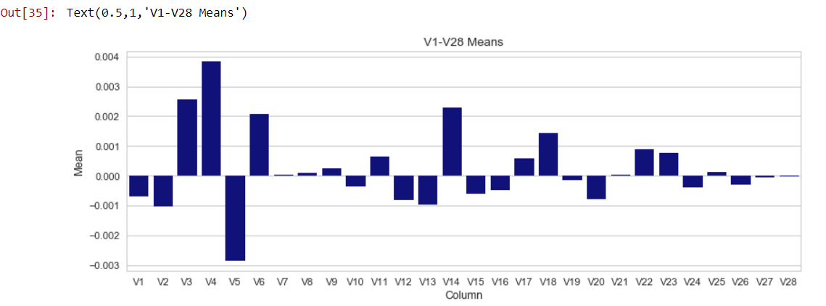
Means of V1-V28
It can be clearly seen that V1-V28 have approximately zero mean.

Slide 19
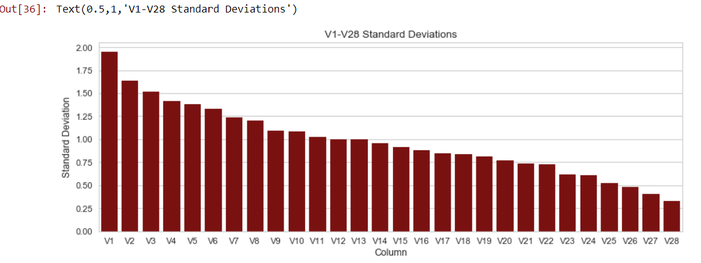
Standard Deviation
We see that most of the pca variables are having unit variance but some of them are having S.D as low as 0.3 and as high as 1.9.

Slide 20
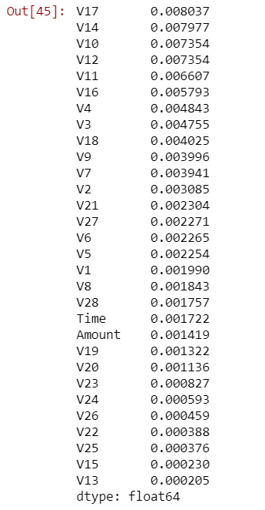
Mutual Information between Fraud and the Predictors
The five most correlated variables with the target labels (Fraud) are:
V17 > V14 > V10 > V12 > V11

Slide 21
Modeling
We will now examine a Random Forest approach on skewed data. The point is to explore how class imbalance leads to indesirable classification perfomance and whether we can adapt the loss function to create a more appropriate balance between the false positive rate and false negative, rather than just minimizing the total number of misclassifications.
I_{G}=1−p₀²+p₁²
I_{G} =1−w₀p₀²+w₁p₁²

Slide 22
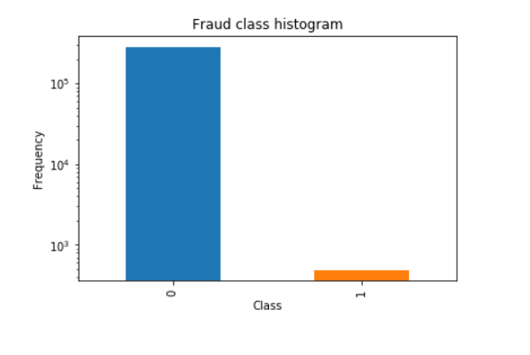
Highly unbalanced dataset!
As we can see the data is totally unbalanced. We cannot use accuracy score as a performance metric.

Slide 23
Unbalanced RandomForestClassifier approach
Using normal unbalanced RandomForestClassifier approach:
TN:56859 FP:5 FN:14 TP:84 FNR=0.14285714285714285 FPR=8.792909397861564e-05
show(*confusion(RandomForestClassifier(random_state=0, n_jobs=-1, n_estimators=10).fit(X_train,y_train),X_test,y_test))
This is usual Random forest classifier which is the default in scikit-learn. All transactions regardless of label are weighted the same.

Slide 24
Balanced RandomForestClassifier approach
Using balanced RandomForestClassifier approach:
Weights are inversely proportional with the frequency of class observaton.
show(*confusion(RandomForestClassifier(random_state=0, n_jobs=-1, n_estimators=10, class_weight="balanced").fit(X_train,y_train),X_test,y_test))
TN:56858 FP:6 FN:21 TP:77 FNR=0.21428571428571427 FPR=0.00010551491277433877
We still have quite the bias toward classification of the majority class.

Slide 25
balances_subsample mode
Using balanced RandomForestClassifier in balanced_subsample mode
This is the same as “balanced” except that weights are computed based on the bootstrap sample for every tree grown.
show(*confusion(RandomForestClassifier(random_state=0, n_jobs=-1, n_estimators=10, class_weight="balanced_subsample").fit(X_train,y_train),X_test,y_test))
TN:56856 FP:8 FN:17 TP:81 FNR=0.17346938775510204 FPR=0.00014068655036578504

Slide 26
Weighting
Positive samples are given exponentially increasingly higher weight w_{pos} relative to negative samples which have constant but very small weights w_{NEG}=10⁻⁵
^{w_neg = 10**-5}
w_pos_range = np.exp(np.arange(np.log(1), np.log(10**9)))
^{for w_pos in w_pos_range:}
^{print("w_pos: " + str(w_pos))}
show(*confusion(RandomForestClassifier(random_state=0, n_jobs=-1, n_estimators=10, class_weight={0: w_neg, 1: w_pos}).fit(X_train,y_train),X_test,y_test))
The weights w_{NEG} and w_{POS} become hyperparameters that we can optimize.

Slide 27
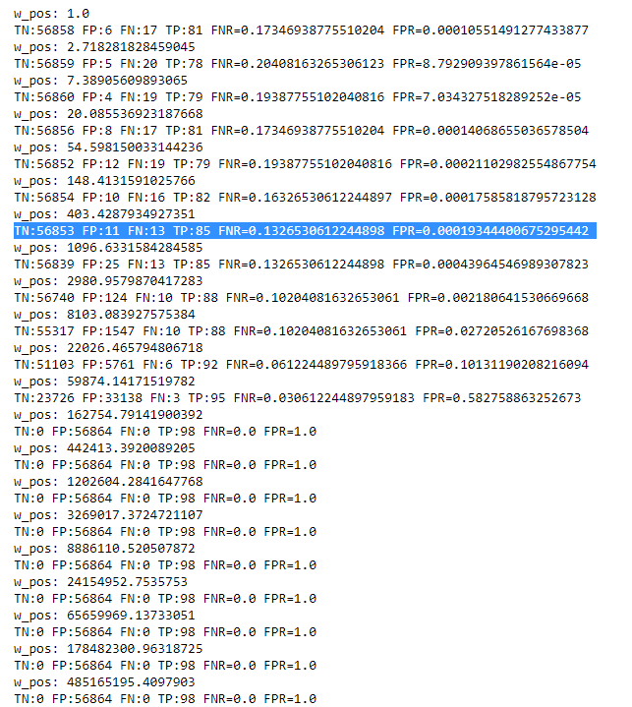

Slide 28
Evaluation Metric

Slide 29
Inference
It is feasible to strike a balance between false negatives and false positives using a class weight hyper parameter. The optimal setting of this hyperparameter depends not only on the cost of false negatives and the cost of false positives, but also on the class imbalance.

Slide 30
SMOTE Technique
SMOTE stands for Synthetic Minority Over-sampling Technique.
SMOTE creates new synthetic points in order to have an equal balance of the classes.
It will take more time to train but will be more accurate than random undersampling.

Slide 31
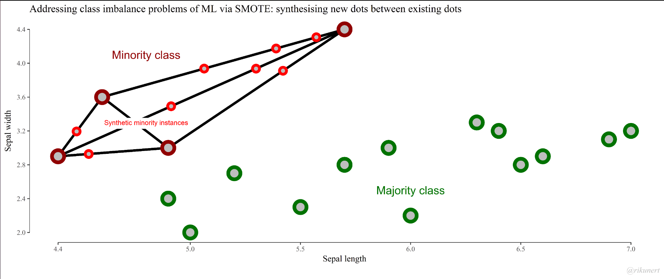

Slide 32
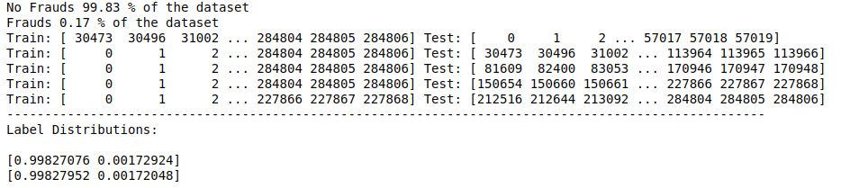
StratifiedKFold is used to generate test sets such that all contain the same distribution of classes, or as close as possible.

Slide 33
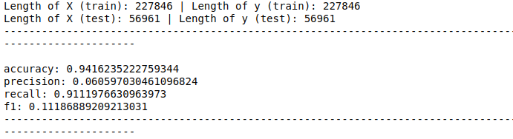
Training Set(Pipeline Model)

Slide 34
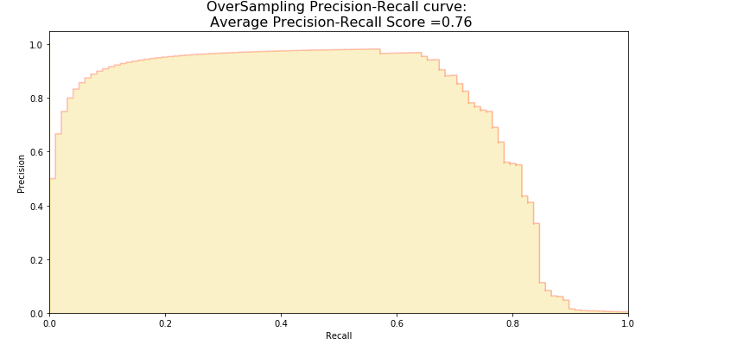
Precision-Recall Curve

Slide 35
Conclusion
As we are making a comparison between the Random Forest and the Smote Model, we are making use of average precision-recall score to compare both the models.We can see that the average precision-recall score for the Smote Model is 0.75 where as for Random Forest it is 0.73. We can clearly infer from the above data that the Smote technique works better when compared to Random Forest.
Final Comparison is made between our work(smote model)and the research paper referred. As we shall see in the next slide how this comparison works by comparing the accuracy between our model and the accuracy mentioned in the previous papers.

Slide 36
Research Paper Vs Our Work

Slide 37

Research Paper 1
Random Forest for Credit Card Fraud Detection
Tongji University
978–1–5386–5053–0/18/$31.00 © 2018 IEEE

Slide 38

Our Work

Slide 39
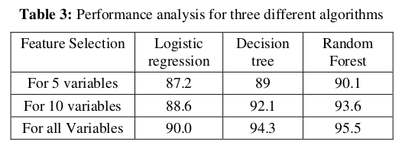
Research Paper 2
International Journal of Applied Engineering Research ISSN 0973-4562 Volume 13, Number 24 (2018) pp. 16819-16824
© Research India Publications. http://www.ripublication.com
16819
Machine Learning For Credit Card Fraud Detection System
Lakshmi S V S S1
,Selvani Deepthi Kavila2
1,2Department of CSE, Anil Neerukonda Institute Of Technology And Sciences(A), Visakhapatnam-531162,India

Slide 40
THANK YOU

